Slide 1

Sequential Sytems. Part 2. Registers. Counters. Shift Registers. (Lab. 4, 5)
IAX 0600 Digital Systems Design
Alexander Sudnitson
Tallinn University of Technology

Slide 2
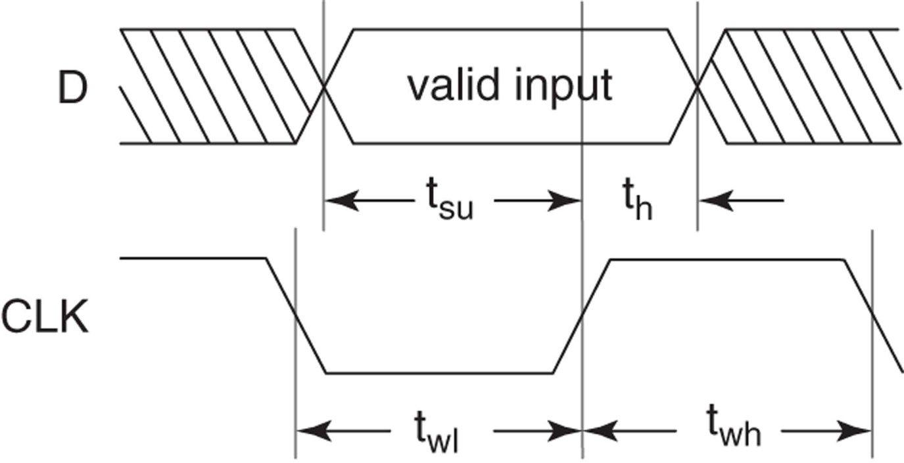
Timing requirements
Physical memory elements have timing requirements that must be met to ensure their proper operation. For example, input data to a D flipflop must be stable for a period of time (setup time, t_{su}) before a triggering clock edge and must remain stable for a period of time (hold time, t_{h}) after a triggering clock edge. There is also a minimum clock width requirement (clock width, t_{wh}) that must be met.

Slide 3
Metastable event Violating Setup Time or Hold Time Requirements
One result of not meeting setup time or hold time requirements is the possibility of a metastable event. The term metastable event denotes the situation where a flip-flop’s output either remains between valid states for an unusually long period of time or fails to complete the transition to the desired state after a triggering clock edge. Metastable events can result in incorrect system operation.

Slide 4
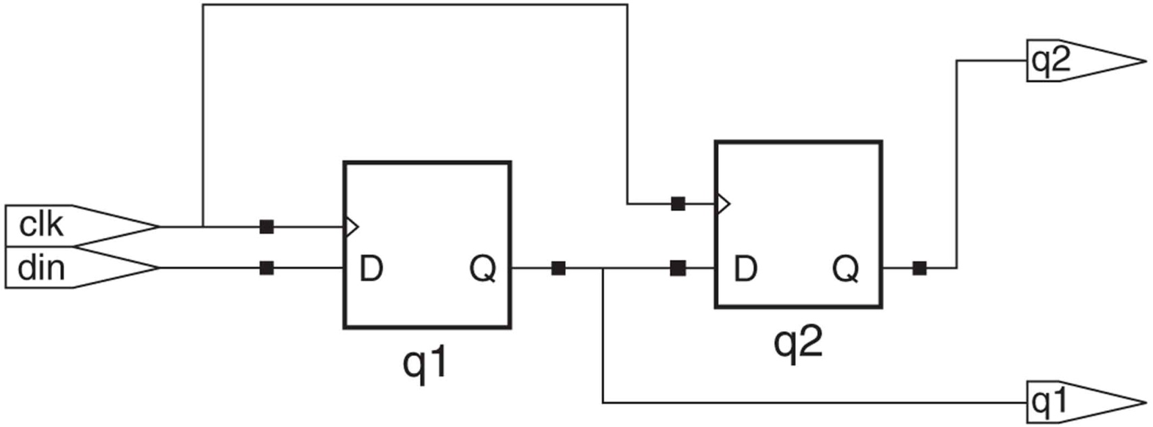
Synchronous input data
If the Q output of one flip-flop provides input data to a second flip-flop that uses the same clock signal, the input data to the second flip-flop is synchronous input data.
With synchronous input data and a sufficiently long clock period it is easy to ensure that a flip-flop’s setup time and hold time requirements are met.

Slide 5
Use of flip-flops versus latches
Generally, the use of latches as simple storage elements is not recommended.
Traditionally, latches had the advantage in custom IC design of requiring fewer transistors, thus requiring half as much IC area. However, latches in FPGAs are typically implemented using memory elements that can be configured as either a latch or flip-flop. The amount of chip area taken by a configurable memory element in a FPGA is fixed, regardless of whether it is configured as a latch or flip-flop. More importantly, use of latches increases the timing complexity of a design. This necessitates much more careful design techniques and timing analysis to ensure correct operation.

Slide 6
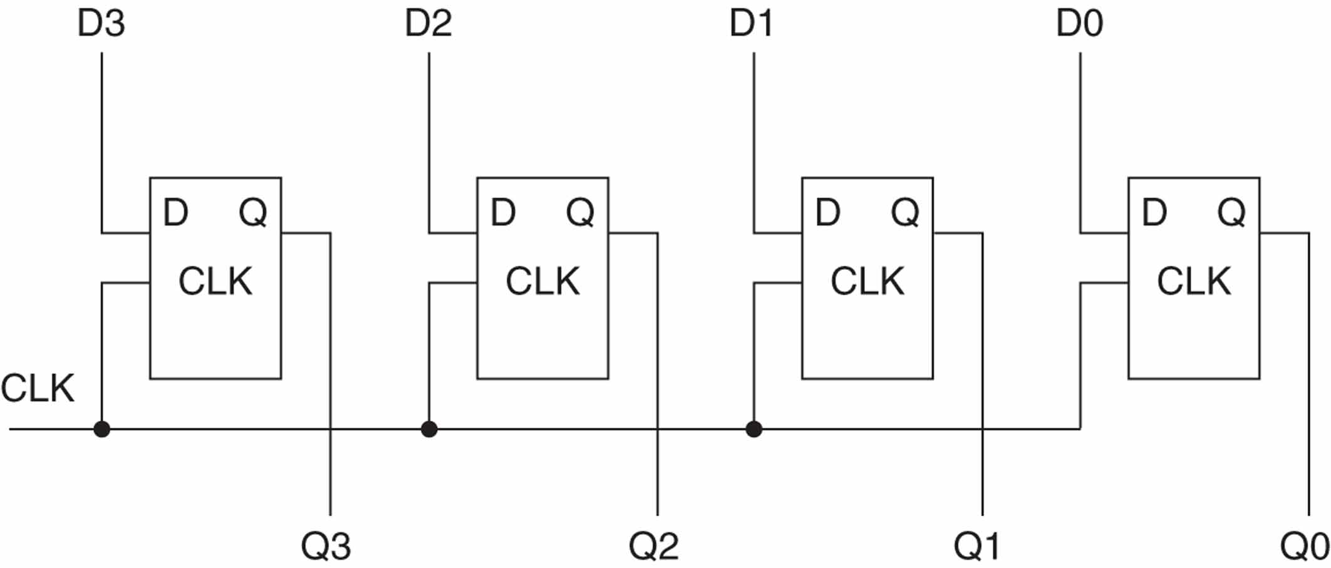
Multibit latches and registers
Either latches or flip-flops can be interconnected to form memory structures that store multiple bits of information as a unit. Flip-flops can also be combined to form shift registers, shift register counters, and counters.

Slide 7
A multibit D latch
entity octal_d_latch is
port (d: in std_logic_vector(7 downto 0);
clk, set_bar, clear_bar: in std_logic;
q: out std_logic_vector(7 downto 0));
end octal_d_latch;
architecture behavioral of octal_d_latch is
begin
process (d, clk, set_bar, clear_bar)
begin
if set_bar = '0' then q <= (others => '1');
elsif clear_bar = '0' then q <= (others => '0');
elsif clk = '1' then q <= d;
end if;
end process;
end behavioral;
This octal D latch is with asynchronous set and clear
if statement is without else close

Slide 8
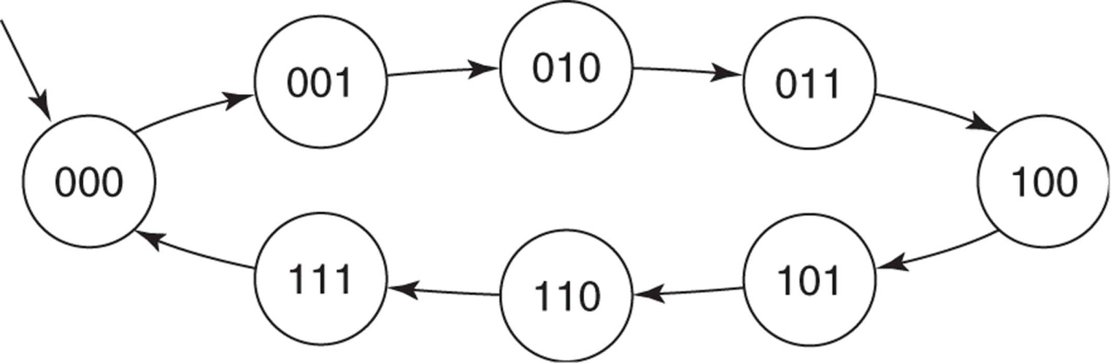
Counters
Counters are simple examples of finite state machines (FSMs).
Counters are used to count events, generate time intervals, generate events, and divide down an input signal to create a lower frequency output signal.
A counter’s next state is the state it goes to from its present state at a triggering clock edge. A simple counter transitions from one unique state to another, until it eventually returns to its initial state, after which its state transitions repeat.
State diagram for a 3-bit counter

Slide 9
Counters
A straightforward approach to the description of a counter involves use of arithmetic operators. For example, an up counter is simply a register whose value is incremented. Incrementing a register is accomplished by adding 1 to its present value.
But in VHDL, addition and subtraction operations are predefined for only the types integer, real, and time. Since we are using std_logic or std_logic_vector types for inputs and outputs, we cannot use the predefined + and – operators directly. Two ways to solve this problem are:
1. Use type integer signals or variables along with the predefined + and – operators, then use functions to convert the integer results to std_logic.
2. Use type unsigned from the package NUMERIC_STD, which also overloads the + and – operators for this type, then convert the unsigned results to std_logic_vector.

Slide 10
Counters
using an integer signal
Signal count_int is declared as type integer with a range of 0 to 15. This range is consistent with that of a 4-bit binary counter. Signal count_int maintains the counter’s value and is incremented by the process at each triggering clock edge. Use of signal count_int is another example of the technique used to read the value assigned to a mode out port.
library ieee;
use ieee.std_logic_1164.all;
use ieee.numeric_std.all;
entity counter_4bit is
port (clk, reset_bar: in std_logic;
count: out std_logic_vector (3 downto 0));
end counter_4bit;
architecture behav_int of counter_4bit is
signal count_int : integer range 0 to 15;
begin

Slide 11
Counters
using an integer signal
cnt_int: process (clk, reset_bar)
begin
if reset_bar = '0' then
count_int <= 0;
elsif rising_edge(clk) then
if count_int = 15 then
count_int <= 0;
else
count_int <= count_int + 1; --read and increment count_int
end if;
end if;
end process;
count <= std_logic_vector(to_unsigned(count_int,4));
end behav_int;

Slide 12
Counters
using an integer signal
Signal count_int is needed for two reasons. First, we want an integer signal so that we can use the predefined + operator. This integer signal is then converted to a std_logic_vector for output. Second, in order to increment this signal, we need to be able to read the present value of the counter. We can’t read that value directly from count, because count is a mode out port.
The concurrent assignment statement
count <= std_logic_vector(to_unsigned(count_int,4));
first uses the function to_unsigned to convert integer signal count_int into a 4-bit unsigned vector. The value returned by this function is then converted to type std_logic_vector and assigned to output count. Since this assignment statement is a concurrent function call, it executes anytime there is an event on the parameter count_int of the function to_unsigned.

Slide 13
Counter
library ieee;
use ieee.std_logic_1164.all;
use ieee.numeric_std.all;
entity counter_4bit is
port (clk, reset_bar: in std_logic;
count: out std_logic_vector (3 downto 0));
end counter_4bit;
architecture behav_us of counter_4bit is
signal count_us : unsigned(3 downto 0);
begin
cnt_us: process (clk, reset_bar)
begin
if reset_bar = '0' then count_us <= "0000";
elsif rising_edge(clk) then count_us <= count_us + 1;
end if;
end process;
count <= std_logic_vector(count_us);
end behav_us;
using unsigned signal
An advantage of using an unsigned type in a binary counter is that we do not have to check whether the count is at its maximum value to force it to 0 on the next count. An unsigned vector naturally rolls over to 0 on the next count after it has reached all 1s or (2^{n} – 1).

Slide 14
100MHz to 1MHz Clock Divider
signal clock_1MHz: std_logic;
signal counter: integer range 0 to 99;
begin
process (clock_100MHz)
begin
if clock_100MHz'event and clock_100MHz = ‘1’ then
if counter < 99 then
counter <= counter + 1;
clock_1MHz <= ’0’;
else
counter <= 0;
clock_1MHz <= ’1’;
end if;
end if;
end process;

Slide 15
More about ports (port mode IN)
Data comes in this port and can only be read within the entity. It can appear only on the right side of a signal or variable assignment.
Port signal
Entity
a
Driver resides
outside the entity

Slide 16
More about ports (port mode OUT)
The value of an output port can only be updated within the entity. It cannot be read. It can only appear on the left side of a signal assignment.
Entity
Port signal
z
Output (signal z) cannot be read within the entity
c
Driver resides
inside the entity
c <= z

Slide 17
More about ports (port mode INOUT)
The value of a bi-directional port can be read and updated within the entity model. It can appear on both sides of a signal assignment.
Port signal
Entity
a
Signal can be
read inside the entity
Signal can be
read inside the entity
Driver may reside both inside and outside of the entity
Driver may reside both inside and outside of the entity

Slide 18
More about ports (port mode OUT with extra signal)
Entity
Port signal
x
z
Signal x can be
read inside the entity
c
Driver resides
inside the entity
z <= x
c <= x

Slide 19
More about ports (port mode BUFFER)
Buffer: Used for a signal that is an output from an entity. The value of the signal can be used inside the entity, which means that in an assignment statement the signal can appear on the left and right sides of the <= operator
Entity
Port signal
z
c
Port signal Z can be
read inside the entity
c <= z
Driver resides
inside the entity

Slide 20
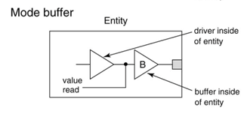
More about ports (port mode BUFFER)
Buffer: A mode buffer port is an output port that can also be read from inside the architecture body. The signal is modeled as if the driver is connected to the port through a buffer. Statements in the entity’s architecture body can read and write the port. Therefore, the port’s name can appear on either side of a signal assignment statement. The value of the signal can be used inside the entity, which means that in an assignment statement the signal can appear on the left and right sides of the <= operator.
Prior to IEEE Std 1076-2002 there was a restriction that, in a port map, a formal port ofmode buffer could be associated with an actual that was itself a port only if the actual port was also of mode buffer.

Slide 21
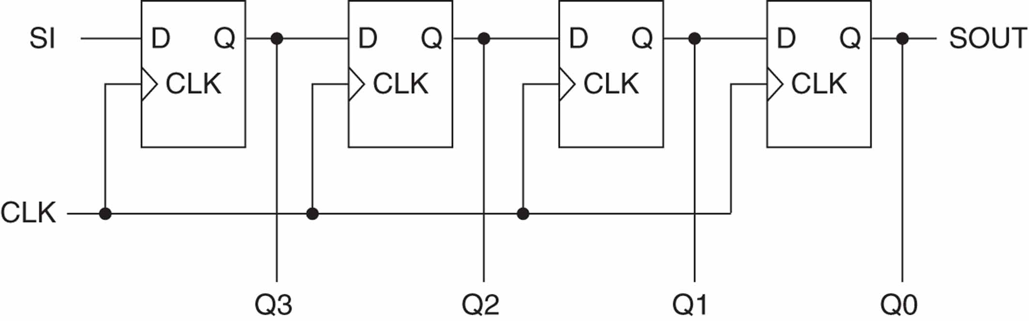
Shift registers
Bits stored in a simple shift register are shifted one bit position (right or left) at each triggering clock edge. If the shift is to the right, all bits are shifted one position to the right, the input value (SI) is shifted into the leftmost bit position, and the original value in the rightmost bit position (SOUT) is shifted out of the register.
The primary uses for shift registers are serial-to-parallel conversion, parallel-to-serial conversion, and synchronous delay.

Slide 22
Shift registers
using a buffer mode port
entity shiftreg_rb is
port (si, clr_bar, clk : in std_logic;
qout : buffer std_logic_vector (3 downto 0));
end shiftreg_rb;
architecture behavior of shiftreg_rb is
begin
process (clk)
begin
if rising_edge(clk) then
if clr_bar = '0' then qout <= "0000"; -- clear shift register
else
qout(0) <= qout(1); qout(2) <= qout(3); qout(1) <= qout(2); qout(3) <= si;
end if;
end if;
end process;
end behavior;
To describe the shift, we need to be able to read the present value in the shift register. If its mode is out, port qout cannot be directly read. Instead, qout is declared as mode buffer.
shift right
The order in which the flip-flop outputs are read and their values assigned does not matter.

Slide 23
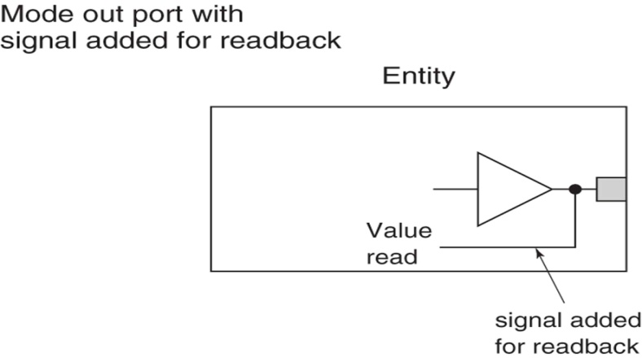
Shift registers
using to read a mode out port
entity shiftreg_rs is
port (si, clr_bar, clk : in std_logic;
qout : out std_logic_vector (3 downto 0));
end shiftreg_rs;
architecture behavior of shiftreg_rs is
signal q : std_logic_vector(3 downto 0);
begin
process (clk)
begin
if rising_edge(clk) then
if clr_bar = '0' then qout <= "0000"; -- clear shift register
else
q(0) <= (1); q(2) <= q(3); q(1) <= q(2); q(3) <= si;
end if;
end if;
end process;
qout <= q;
end behavior;
Again assignments are listed in a random order. Since these are signal assignments, their values don’t change during the current execution of the process (simulation cycle).

Slide 24
Shift registers
using variables
entity shiftreg_rv is
port (si, clr_bar, clk : in std_logic;
qout : out std_logic_vector (3 downto 0));
end shiftreg_rv;
architecture behavior of shiftreg_rv is
begin
process (clk)
variable q := std_logic_vector (3 downto 0);
begin
if rising_edge(clk) then
if clr_bar = '0' then q := "0000"; -- clear shift register
else
q(0) := q(1); q(1) := q(2); q(2) := q(3); q(3) := si;
end if;
qout <= q;
end if;
end process;
end behavior;
If a variable is used, the order of assignment to elements of the variable vector is critical, because each assignment takes effect immediately.

Slide 25
Shift registers
using concatinatination operator to shift
A shift operation can be written more concisely using the concatenation operator and slices. The concatenation operator is predefined for all one-dimensional array types.
q(0) := q(1);
q(1) := q(2);
q(2) := q(3);
q(3) := si;
can be replaced by a single assignment statement:
q := si & q(3 downto 1);
si is assigned to q(3) and slice q(3) down to q(1) is assigned to q(2) down to q(0).

Slide 26
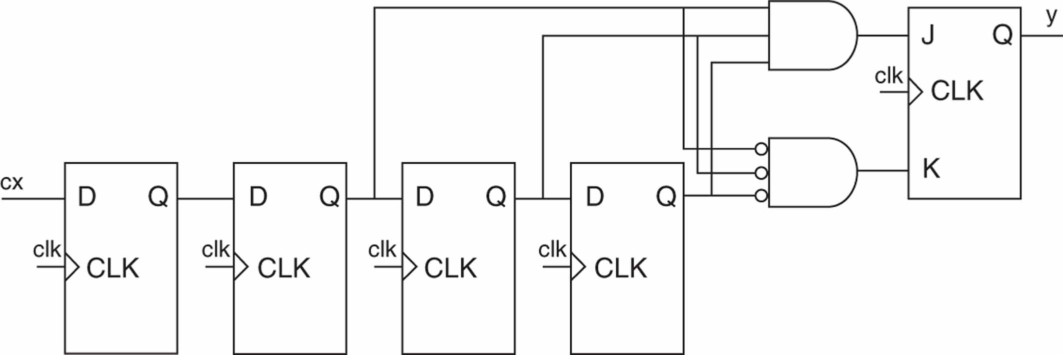
Digital noise filter
The purpose of this filter is to reject short-duration noise spikes at its data input cx. The filter’s output y can change only after its input has had the same value at three consecutive triggering clock edges. Input changes that have a duration of two or fewer clock cycles are rejected (don’t cause a change in the output). Examination of the logic diagram indicates that a valid input change is delayed by five clock periods, one for each flip-flop, before it is seen at the output.
The first flip-flop of the shift register is used to
reduce the chances of a metastable event if the input data is asynchronous.

Slide 27
Digital noise filter
entity filter is
port (cx, clk, rst_bar : in std_logic; y : out std_logic);
end;
architecture behavior of filter is
begin
synch: process (clk)
variable q : std_logic_vector(3 downto 0);
begin
if rising_edge(clk) then
if rst_bar = '0' then q := "0000"; y <= '0';
else
if q(2 downto 0) = "111" then y <= '1';
elsif q(2 downto 0) = "000" then y <= '0';
else
null;
end if;
q := cx & q(3 downto 1); -- right shift
end if;
end if;
end process;
end behavior;

Slide 28
VHDL shift operators
Let A = “10010101”
A sll 2 = “01010100” --shift left logical, filled with ‘0’
A srl 3 = “00010010” --shift right logical, filled with ‘0’
A sla 3 = “10101111” --shift left arithmetic, filled with right bit
A sra 2 = “11100101” --shift right arithmetic, filled with left bit
A rol 3 = “10101100” --rotate left by 3
A ror 5 = “10101100” --rotate right by 5

Slide 29
Debounce circuit
If you press any of pushbuttons on the FPGA board they may bonce slightly for a few milliseconds before settling. This means that instead of the input to the FPGA going from 0 to 1 cleanly it may bounce back and forth between 0 and 1 for a few milliseconds. This can be a serious problem in sequential circuits.
This can be used to debounce a pushbutton input signal, inp.
outp
AND
inp
delay1
delay2
delay3
cclk

Slide 30
Debounce VHDL -1-
use IEEE.STD_LOGIC_1164.all;
entity debounce4 is
port(
inp : in STD_LOGIC_VECTOR(3 downto 0);
cclk : in STD_LOGIC;
clr : in STD_LOGIC;
outp : out STD_LOGIC_VECTOR(3 downto 0)
);
end debounce4;

Slide 31
Debounce VHDL -2-
architecture debounce4 of debounce4 is
signal delay1, delay2, delay3: STD_LOGIC_VECTOR(3 downto 0);
begin
process(cclk, clr)
begin
if clr = '1' then
delay1 <= "0000";
delay2 <= "0000";
delay3 <= "0000";
elsif cclk'event and cclk = '1' then
delay1 <= inp;
delay2 <= delay1;
delay3 <= delay2;
end if;
end process;
outp <= delay1 and delay2 and delay3;
end debounce4;

Slide 32
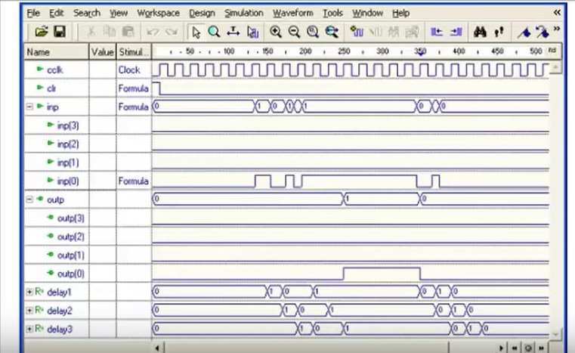
Simulation of VHDL program
Bouncing
Clean signal
It is important to use a low frequency for cclk to make sure all debounces are eliminated.

Slide 33
Clock pulse
This is a circuit that will produce a single clean clock pulse.
The difference from the debounce circuit is that the complement of drlay3 is the last input to the AND gate.
outp
AND
inp
NOT
delay1
delay2
delay3
cclk

Slide 34
Clock pulse VHDL program
library IEEE;
use IEEE.STD_LOGIC_1164.all;
entity clock_pulse is
port(
inp : in STD_LOGIC;
cclk : in STD_LOGIC;
clr : in STD_LOGIC;
outp : out STD_LOGIC
);
end clock_pulse;
architecture clock_pulse of clock_pulse is
signal delay1, delay2, delay3: STD_LOGIC;
begin
process(cclk, clr)
begin
if clr = '1' then
delay1 <= '0';
delay2 <= '0';
delay3 <= '0';
elsif cclk'event and cclk = '1' then
delay1 <= inp;
delay2 <= delay1;
delay3 <= delay2;
end if;
end process;
outp <= delay1 and delay2 and not delay3;
end clock_pulse;

Slide 35
Clock pulse VHDL program
architecture clock_pulse of clock_pulse is
signal delay1, delay2, delay3: STD_LOGIC;
begin
process(cclk, clr)
begin
if clr = '1' then
delay1 <= '0';
delay2 <= '0';
delay3 <= '0';
elsif cclk'event and cclk = '1' then
delay1 <= inp;
delay2 <= delay1;
delay3 <= delay2;
end if;
end process;
outp <= delay1 and delay2 and not delay3;
end clock_pulse;

Slide 36
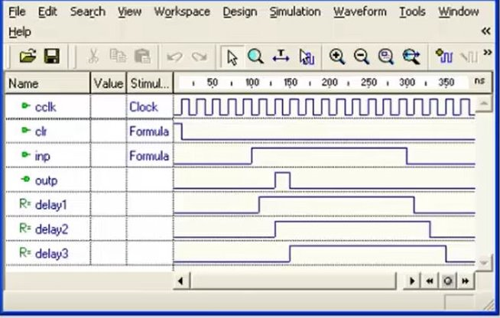
Simulation of clock pulse VHDL program

Slide 37
Rising Edge Single Pulse Generation
Here we use concurrent assignment statement. This listing is proposed in Lab description
button_buf1 <= button_input_signal when rising_edge(clock_100MHz);
button_buf2 <= button_buf1 when rising_edge(clock_100MHz); button_pulse <= button_buf1 and not button_buf2;

